Slide 1

(Management Topic in Environmental Studies)
B. Tech 7TH Semester
Noise pollution
Department: Chemistry
Subject: MTES (CHM 2049)

Slide 2

Contents
Introduction to Noise Pollution
Sources of Noise pollution
Impact on health due to noise pollution
Properties of Sound and Noise Related Numerical
Sound perception and Measurement and Equivalent continues noise level
Ambient Air quality standards in respect of Noise
Permissible Noise Level standards for house appliances
Physical conditions for Noise measurement
Noise pollution Control measure
Notes:
2

Slide 3
Noise Pollution
Introduction
It is an unpleasant and disturbing sound, responsible for several auditory and no-auditory adverse effects on human health and well-being, ranging from simple annoyance to hearing loss.
According to WHO, Noise is considered as a major concerned environmental factor for an unhealthy society (WHO, 2011)
Noise is a perpetual, significant contributor to occupational diseases in numerous working environments.
Noise health effects depend on the combination of intensity, frequency and duration of exposure to noise

Slide 4
Sources of Noise Pollution
Industries
Rail and Air traffic
Road traffic
Construction
Indoor sources
Loud speakers
Fire crackers

Slide 5
Properties of Sound
Physically: Sound is a mechanical disturbance propagated as a wave motion in air and other elastic and mechanical media such as water or, steel.
Physiologically: Sound is an auditory sensation evoked by this physical phenomenon.(not all sound wave evoke an auditory sensation, e.g., the frequency of ultrasound is too high to excite the sensation of hearing)
Sound waves involve a succession of compressions and rarefactions of an elastic medium such as air.
The sound waves are characterized by: the amplitude of pressure changes, their frequency and the velocity of propagation.
Wavelength=speed of Sound/ frequency.
Speed of sound in air(20°C)=344 m/s.
Sound travels much faster in solids than in air.
(wood=3,962 m/s, Steel=5,029 m/s)

Slide 6
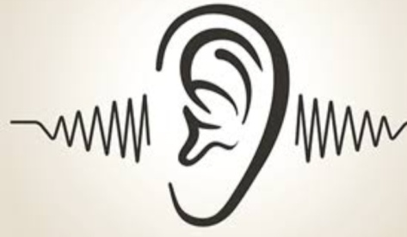
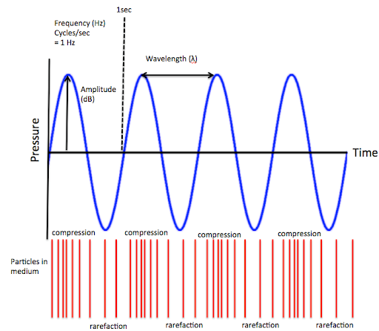
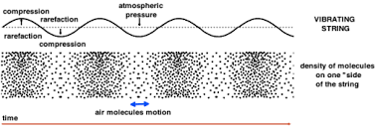
Number of compressions and rarefactions per unit time (sec)
frequency
unit=hertz(Hz)
Rate at which energy is transmitted by a sound wave
Sound Power
Represented in terms of watt. Watt=Joules/Sec
Frequency range
(20-20,000 Hz)

Slide 7
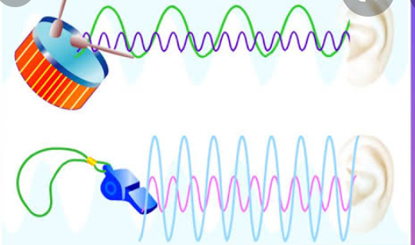
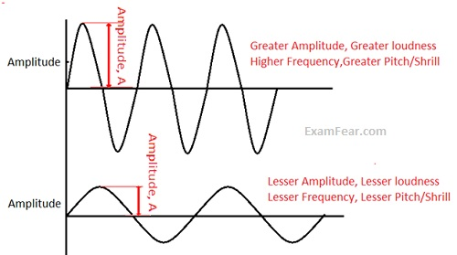

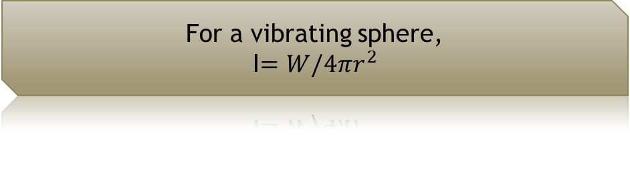
Average sound power per unit area in the direction of propagation of sound wave.
I=W/A (watt/m²)
Sound Intensity(I)
For a vibrating sphere,
I$=W/4πr^{2}$
When Noise is far away from the source, Sound intensity (I)
I=P²/ℓe
P=Sound Pressure
ℓ=Density of the medium i.e., air=1.185
e=speed of Sound i.e.,340m/sec.

Slide 8
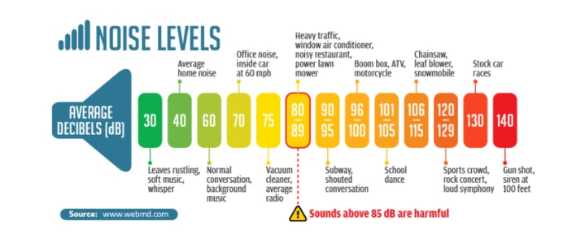
Decibel
A scale ten times the logarithm of the ratio of a measured quantity to specified reference quantity.
It represents sound level.
Sound power level, Lw=10log10 (W/W0)
W=measured Sound power
W0=Reference sound power(10ˉ¹²W)

Slide 9
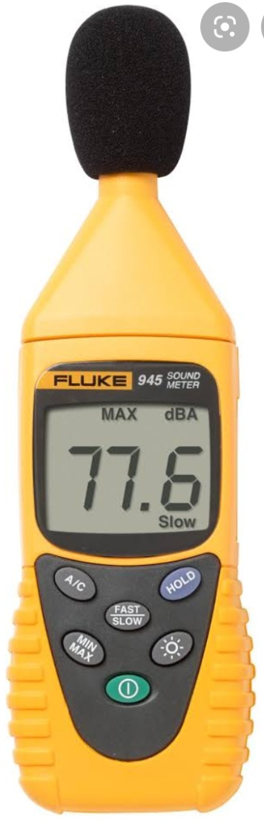
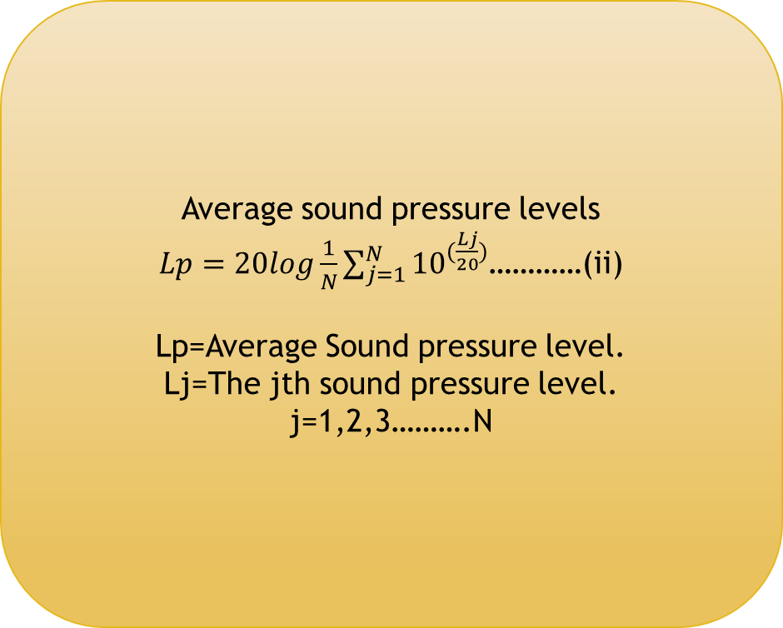
Sound pressure level (Lp)
Sound is measured with a Sound level meter which is usually a portable self contained instrument incorporating a microphone amplifier, a voltmeter and a attenuator. The whole of which is calibrated to read sound pressure level directly.
Sound pressure level, Lp(dB)=10log10 (P/Pr)²…..(i)
P=measured Sound Pressure
P_{r}=Reference sound Pressure(20µp)
Average sound pressure levels
$Lp=20log\frac{1}{N}\sum_{j=1}^{N}{{10}^{(\frac{Lj}{20})}}$…………(ii)
Lp=Average Sound pressure level.
Lj=The jth sound pressure level.
j=1,2,3……….N

Slide 11
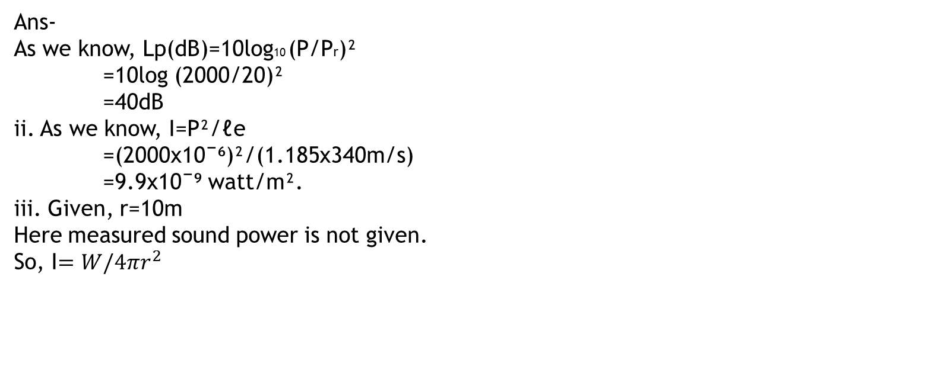
Problems
1. The sound power generated from a moving tractor is 0.001 watt. What is the Sound Power Level?
Ans-
As we know, Lw=10log10 (w/w0)
=10log (0.001/10ˉ¹²)
=90 dB
2. If a sound source has a pressure of 2000µp at 10m distance. Configure the sound pressure level in dB?
- Sound Intensity in watt/m².
- Sound Power in watt. (w?/Lw)
Ans-
As we know, Lp(dB)=10log10 (P/Pr)²
=10log (2000/20)²
=40dB
ii. As we know, I=P²/ℓe
=(2000x10ˉ⁶)²/(1.185x340m/s)
=9.9x10ˉ⁹ watt/m².
iii. Given, r=10m
Here measured sound power is not given.
So, I$=W/4πr^{2}$

Slide 12
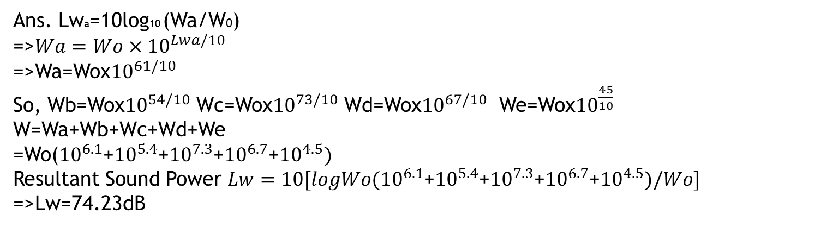
I = w/4πr²
9.9x10ˉ⁹=W/4x3.14x100
W= 1.24x10 ˉ⁵watt
So, Lw=10log10 (w/w0)
=>Lw=10log ((1.24x10 ˉ⁵)/10ˉ¹²)
=>Lw=71 DB
3. Determine the sound power level by combining 5 sound levels i.e., 61 dB, 54 dB, 73 dB, 67 dB and 45dB?
Ans. Lwa=10log10 (Wa/W0)
=>$Wa=Wo×{10}^{Lwa/10}$
=>Wa=Wox${10}^{61/10}$
So, Wb=Wox${10}^{54/10}$ Wc=Wox${10}^{73/10}$ Wd=Wox${10}^{67/10}$ We=Wox${10}^{\frac{45}{10}}$
W=Wa+Wb+Wc+Wd+We
=Wo(${10}^{6.1}$+${10}^{5.4}$+${10}^{7.3}$+${10}^{6.7}$+${10}^{4.5})$
Resultant Sound Power $Lw=10[logWo({10}^{6.1}$+${10}^{5.4}$+${10}^{7.3}$+${10}^{6.7}$+${10}^{4.5})/Wo]$
=>Lw=74.23dB
Here, Lwa=61dB, Lwb =54dB, Lwc=73dB, Lwd=67dB and Lwd=45dB

Slide 13
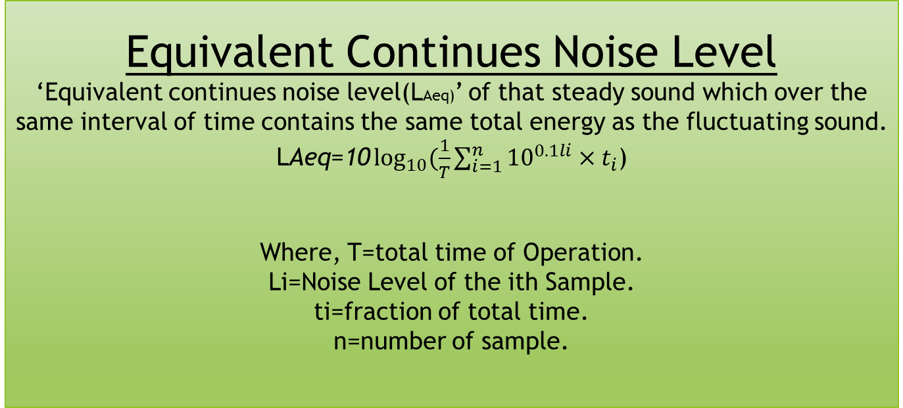
Equivalent Continues Noise Level
‘Equivalent continues noise level(LAeq)’ of that steady sound which over the same interval of time contains the same total energy as the fluctuating sound.
$\text{L}\text{A}\text{eq}\text{=10}\log_{10}{(\frac{1}{T}\sum_{i=1}^{n}{{10}^{0.1li}×t_{i}}}$)
Where, T=total time of Operation.
Li=Noise Level of the ith Sample.
ti=fraction of total time.
n=number of sample.

Slide 14
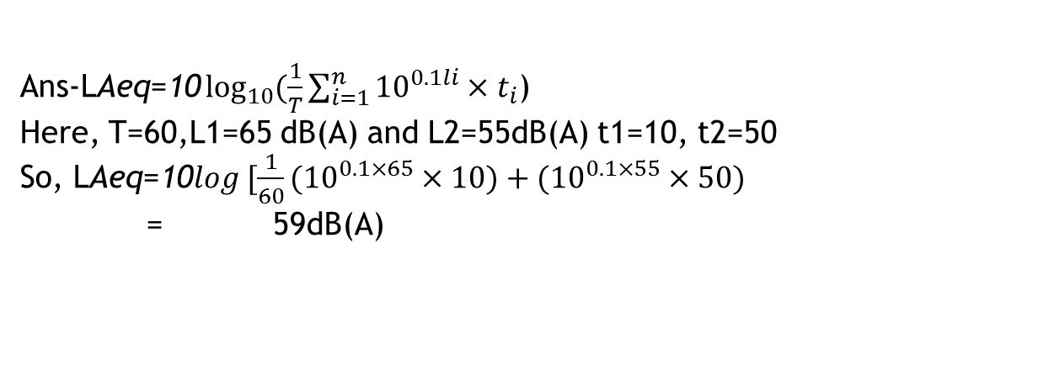
Problem
1.If an Industrial fan generates a noise level of 65 dB(A) for 10 minutes out of every hour. Compute the LAeq, if the background level is 55dB(A)?
$\text{Ans}\text{−}\text{L}\text{Aeq}\text{=10}\log_{10}{(\frac{1}{T}\sum_{i=1}^{n}{{10}^{0.1li}×t_{i}}}$)
Here, T=60,L1=65 dB(A) and L2=55dB(A) t1=10, t2=50
So, $\text{L}\text{Aeq}\text{=10}log [\frac{1}{60}({10}^{0.1×65}×10)+({10}^{0.1×55}×50)$
= 59dB(A)

Slide 15
Ambient Air quality standards in respect of Noise

Slide 16
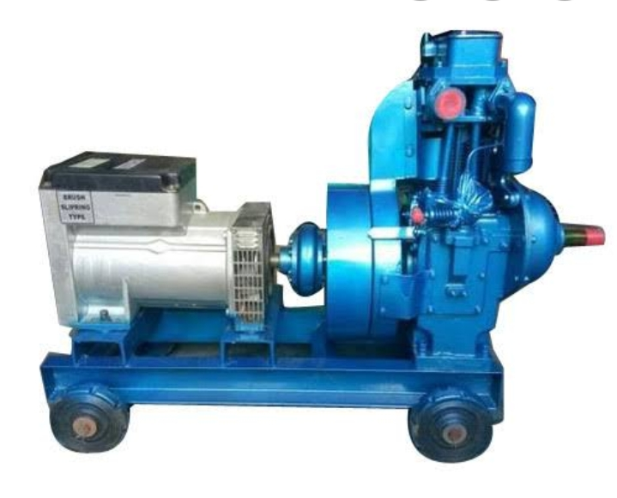
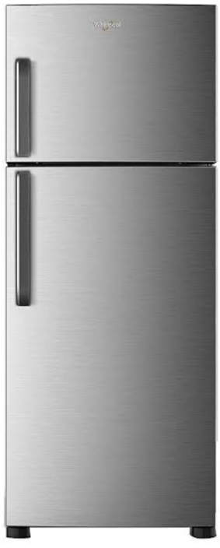
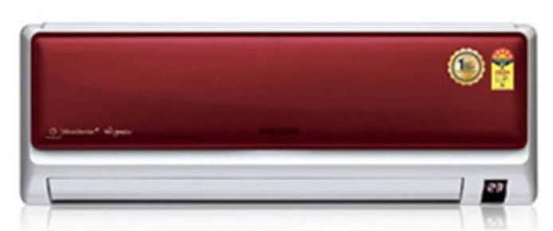
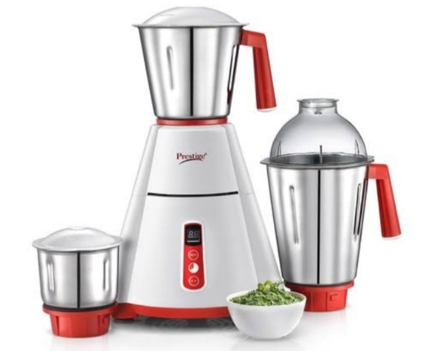
Permissible Noise level standards for house appliances
68 dB(A)
75 dB(A)
85-90 dB(A)
60dB(A)

Slide 17
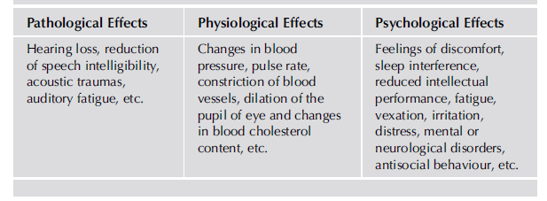
Impact of Noise pollution on health
Noise above 60dB has a negative effect on increased use of psychotropic medication.

Slide 18
Control of Noise
NOISE CONTROL
Noise control at the source
Use of noise protective measures at the receiver
Control of the transmission path

Slide 19
Noise Reduction at the Source
The reduction of the exciting forces e.g., reduction of impacts or, impulsive forces, balancing of moving masses, reduction of frictional forces by proper alignment and lubrication etc.
Application of vibration dumping materials to the radiating surfaces. Rubber plastic between to metallic body
Changes in operating procedure, e.g., a factory, adjacent to the residential areas, suspend or reduce noise generating operations at night
Sound generating instrument running in sound insulating room

Slide 20
Noise control of the transmission path
Sitting e.g., increasing distance between source and the Receiver.
Path deflection e.g., by use of barrier. Sound deflector tile ,
Properly designed enclosures.
Absorption e.g., use of sound absorbing material in a room where both the source and the receiver are present in a room.

Slide 21
Protective Measures at the receiver
Use of personal protective equipment, e.g., use of earplugs, earmuffs, noise helmets etc.
Education and public relations.
Exposure Control. e.g., the rotation of personnel so that work assignments in the intense noise area are for a limited period of time only.

Slide 22


